Slide 1
Chapter 14
Chapters
1. Introduction
2. Graphs
3. Descriptive statistics
4. Basic probability
5. Discrete distributions
6. Continuous distributions
7. Central limit theorem
8. Estimation
9. Hypothesis testing
10. Two-sample tests
13. Linear regression
14. Multivariate regression
Multiple Regression Analysis

Slide 2
Multiple Regression…
The simple linear regression model was used to analyze how one interval variable
the dependent variable y is related to one other interval variable
the independent variable x.
Multiple regression allows for any number of independent variables.
We expect to develop models that fit the data better than a simple linear regression model.

Slide 3
The Model…
We now assume we have k independent variables potentially related to the one dependent variable. This relationship is represented in this first order linear equation:
In the one variable, two dimensional case we drew a regression line; here we imagine a response surface.
dependent
variable
independent variables
error variable
coefficients

Slide 4
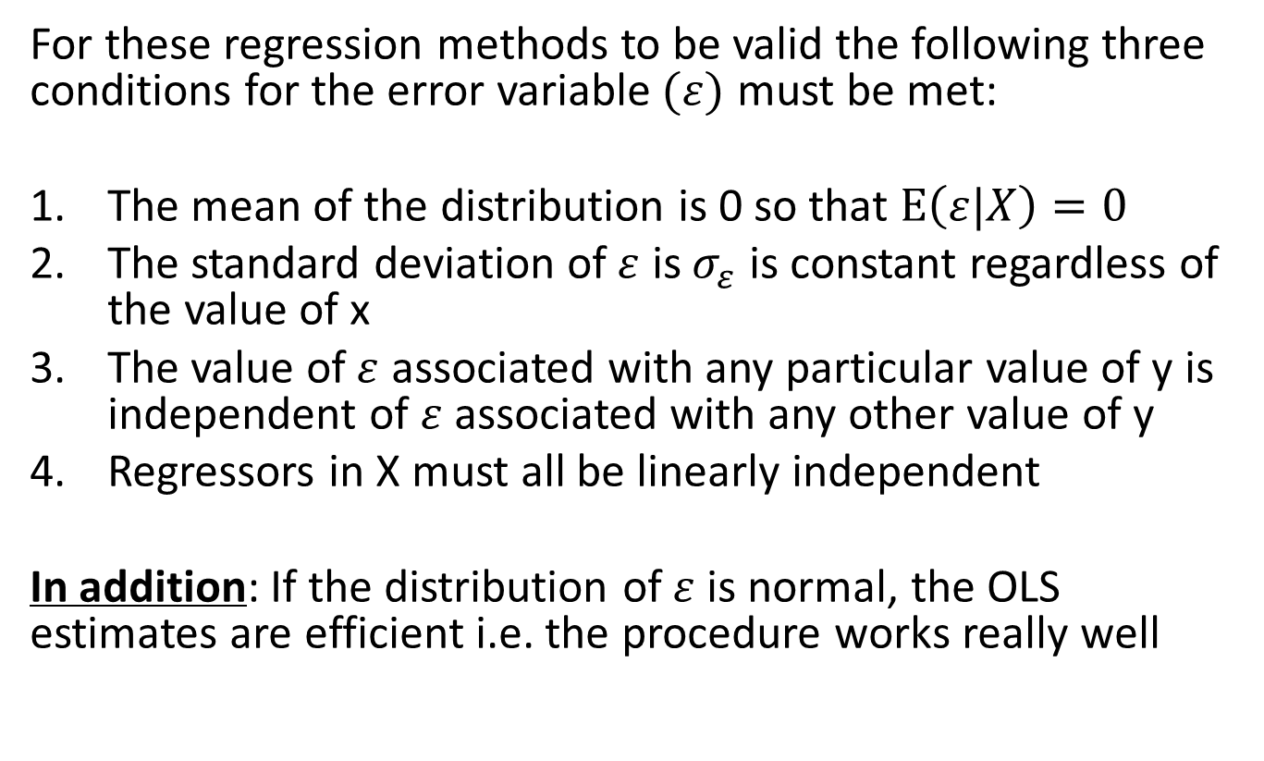
Required Conditions for OLS
For these regression methods to be valid the following three conditions for the error variable$(ε)$ must be met:
The mean of the distribution is 0 so that $E\left(ε|X\right)=0$
The standard deviation of$ε$ is${ σ}_{ε}$ is constant regardless of the value of x
The value of$ε$ associated with any particular value of y is independent of$ε$ associated with any other value of y
Regressors in X must all be linearly independent
In addition: If the distribution of $ε$ is normal, the OLS estimates are efficient i.e. the procedure works really well

Slide 5

Estimating the Coefficients…
The sample regression equation is expressed as:
We will use computer output to:
Assess the model…
How well it fits the data
Is it useful
Are any required conditions violated?
Employ the model…
Interpreting the coefficients
Predictions using the prediction equation
Estimating the expected value of the dependent variable

Slide 6
Regression Analysis Steps…
u Use a computer and software to generate the coefficients and the statistics used to assess the model.
v Diagnose violations of required conditions. If there are problems, attempt to remedy them.
w Assess the model’s fit.
standard error of estimate,
coefficient of determination (R²).
x If u, v, and w are OK, use the model to predict or estimate the expected value of the dependent variable.

Slide 7
Example – La Quinta Inns…
Where should La Quinta locate a new motel? Factors influencing profitability…
Profitability
Competition
Market
Awareness
Demand Generators
Community
Physical
factor
# of rooms within
3 mile radius
Distance to
the nearest
La Quinta inn.
Offices,
Higher Ed.
Median
household
income.
Distance to
downtown.
measure
*these need to be interval data !

Slide 8
Example – La Quinta Inns…
Where should La Quinta locate a new motel?
Several possible predictors of profitability were identified, and data were collected. It is believed that the operating margin (y) is dependent upon these factors:
x₁ = Total motel and hotel rooms within 3 mile radius
x₂ = Number of miles to closest competition
x₃ = Volume of office space in surrounding community
x₄ = College and university student numbers in community
x₅ = Median household income in community
x₆ = Distance (in miles) to the downtown core.

Slide 9
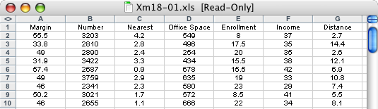
Transformation…
Can we transform this data:
into a mathematical model that looks like this:
margin
awareness
(distance to
nearest alt.)
physical
(distance to
downtown)
competition
(i.e. # of rooms)
…

Slide 10
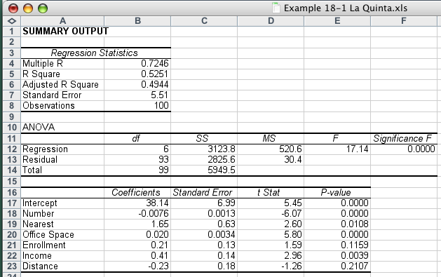

Slide 11
Example - La Quinta Inns…
In Excel: Tools > Data Analysis… > Regression

Slide 12
The Model…
Although we haven’t done any assessment of the model yet, at first pass:
It suggests that increases in the number of miles to closest competition, office space, student enrollment and household income will positively impact the operating margin.
Likewise, increases in the total number of lodging rooms within a short distance and the distance from downtown will negatively impact the operating margin…

Slide 13
Interpreting the Coefficients*
Intercept: b₀ = 38.14 This is the average operating margin when all of the independent variables are zero. It’s meaningless to try and interpret this value, particularly if 0 is outside the range of the values of the independent variables (as is the case here).
# of motel and hotel rooms: b₁ = – 0.0076 Each additional room within three miles of the La Quinta inn, will decrease the operating margin by .0076, ceteris paribus (means all other variables are held constant).
Distance to nearest competitor: b₂ = 1.65 For each additional mile that the nearest competitor is to a La Quinta inn, the average operating margin increases by 1.65, ceteris paribus.
All the other variables are interpreted in the same way.

Slide 14
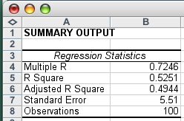

Coefficient of Determination…
Again, the coefficient of determination is defined as:
This means that 52.51% of the variation in operating margin is explained by the six independent variables,
but 47.49% remains unexplained.

Slide 15

Adjusted R² value…
What’s this?
The “adjusted” R² is:
the coefficient of determination adjusted for degrees of freedom.
It takes into account the sample size n, and k, the number of independent variables, and is given by:
The interpretation is the same as R²

Slide 16

Testing the Coefficients…
For each independent variable, we can test to determine whether there is enough evidence of a linear relationship between it and the dependent variable for the entire population…
H₀: = 0 (no effect, or insignificant)
H₁: ≠ 0 (significant)
(for i = 1, 2, …, k) and using:
as our test statistic (with n–k–1 degrees of freedom).

Slide 17
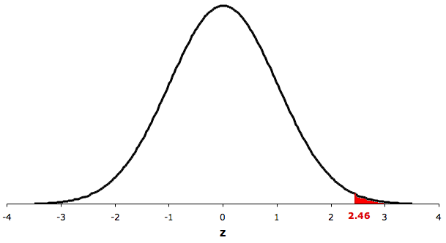
P-Value of Income
Since the p-value is smaller than α, we reject H0. The slope coefficient is significant at the 5% level.
p-value = 2*P(T > 2.96)
=2*abs(t.dist(2.96,93,1))= 0.039
Degrees of freedom: 100-6-1
α/2=0.025
α/2=0.025
p-value/2 =.0019
t
=abs(t.inv(0.05,93))
=1-t.dist(2.96,93,1)=.0019
t_{.025}=-1.98
t_{.025}=1.98
from H0: b5 = 0
t =2.96

Slide 18
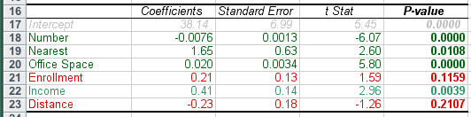
Testing the Coefficients…
We can use our Excel output to quickly test each of the six coefficients in our model…
Thus, the number of hotel and motel rooms, distance to the nearest motel, amount of office space, and median household income are significant to the operating margin.
There is no evidence to infer that college enrollment and distance to downtown center are significant to operating margin.

Slide 19
Using the Regression Equation…
Predict the operating margin if a La Quinta Inn is built at a location where…
u There are 3815 rooms within 3 miles of the site.
v The closest other hotel or motel is .9 miles away.
w The amount of office space is 476,000 square feet.
x There is one college and one university nearby with a total enrollment of 24,500 students.
y Census data indicates the median household income in the area (rounded to the nearest thousand) is $35,000, and,
z The distance to the downtown center is 11.2 miles.
our x_{i}’s…

Slide 20
Categorical variables

Slide 21
Dummy Variables…
What is “Dummy Variable”?
Categorical variable redefined for use in Regression.
Redefined as “indicators”, similar to “success” and “failure”.
For a variable with K categories, you need K-1 dummy variables.
Example: You want to regress on variable “Color” (1 = white, 2 = silver, and 3 = black)
Needs TWO dummies, say, “White” and “Silver”, each takes value of either 0 or 1.
Use dummy variables “White” and “Silver” (but not “Color”) in regression together with other independent variables
Need to drop one of the categories, because x-variables have to be independent.
The dropped category is the BASE-CATEGORY

Slide 22
Dummies
Base category, drop it before you run regression!!
Color | Color Code | Dummy-white | Dummy-silver | Dummy-black
white | 1 | 1 | 0 | 0
silver | 2 | 0 | 1 | 0
silver | 2 | 0 | 1 | 0
black | 3 | 0 | 0 | 1
white | 1 | 1 | 0 | 0
black | 3 | 0 | 0 | 1

Slide 23
How to interpret a dummy variable?
Suppose, we regress “Price” of cars on “White”, “Silver” and some other independent variables
The coefficient for “White” is 100 and that for “Silver” is -50, that means:
Ceteris paribus (which means: everything else equal), white cars are 100 more expensive than black cars.
Ceteris paribus, silver cars are 50 less expensive than black cars.
Black cars is the omitted category!!
(Remember: There were white, silver, and black cars.

Slide 24
Regression Diagnostics…
Calculate the residuals and check the following:
1. Any inaccurate or irrelevant observation? Outlier!
Standardize the residuals and double check any observation with “large” standard score (>3) for accuracy and applicability.
2. Is the error variable Normal?
Draw histogram of the residuals, need bell-shape. Ogive is better because of independence on the interval width. Need S-shape Ogive.
3. Is the mean of error term zero?
Calculate average of residuals, need to be sufficiently close to 0.
4. Is the error variance constant?
Plot the residuals versus the predicted values of y, watch out any clear pattern.
5. Is there Autocorrelation in the errors?

Slide 25
1 Outliers…
An outlier is an observation that is unusually small or unusually large.
E.g. our used car example had odometer readings from 19.1 to 49.2 thousand miles. Suppose we have a value of only 5,000 miles (i.e. a car driven by an old person only on Sundays) — this point is an outlier.

Slide 26
1 Outliers…
Possible reasons for the existence of outliers include:
• There was an error in recording the value
• The point should not have been included in the sample
* Perhaps the observation is indeed valid.
Outliers can be easily identified from a scatter plot.
If the standardized residual of any observation is “large” enough (>3 or <-3), we suspect the point may be an outlier and investigate further.
They need to be dealt with since they can easily influence the least squares line…

Slide 27
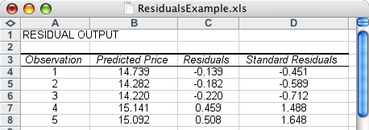
Residual Analysis…
Recall the deviations between the actual data points and the
regression line were called residuals. Excel calculates
residuals as part of its regression analysis:
We can use these residuals to determine whether the error
variable is nonnormal, whether the error variance is constant,
and whether the errors are independent…

Slide 28
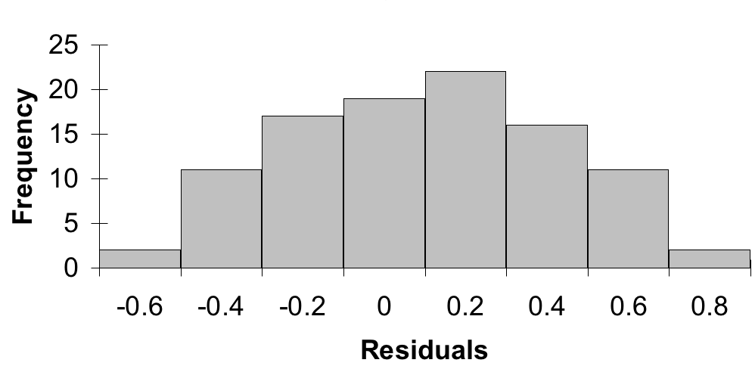
2 Non-normality and 3 Mean of Error Term Equal to 0?
We can take the residuals and put them into a histogram to
visually check for normality…
…we’re looking for a bell shaped histogram with the mean close to zero. ✓

Slide 29
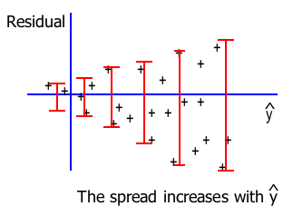
4 Heteroscedasticity…
When the requirement of a constant variance is violated, we
have a condition of heteroscedasticity.
We can diagnose heteroscedasticity by plotting the residual
against the predicted y.

Slide 30

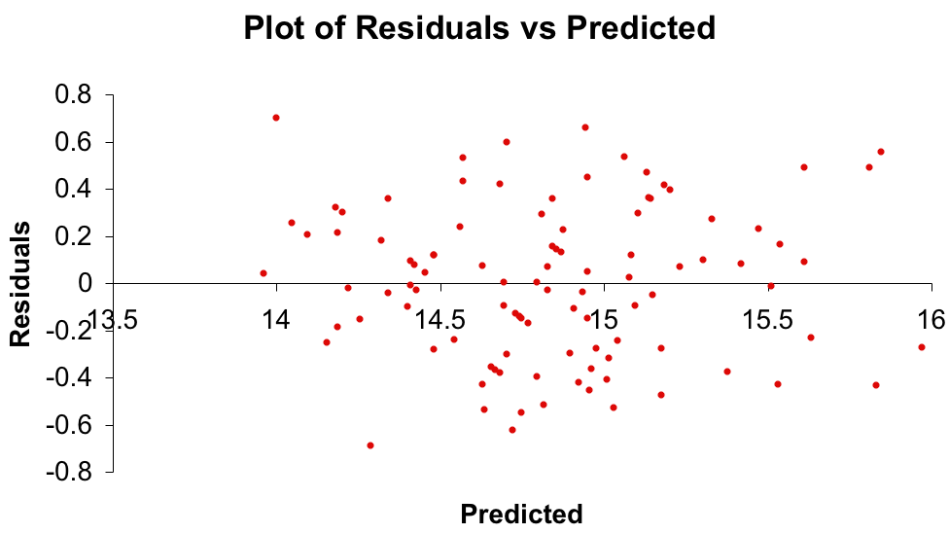
4 Heteroscedasticity…
If the variance of the error variable ( ) is not constant, then we have “heteroscedasticity”. Here’s the plot of the residual against the predicted value of y:
there doesn’t appear to be a change in the spread of the plotted points, therefore no heteroscedasticity
✓

Slide 31
5 Nonindependence of the Error Variable
If we were to observe the auction price of cars every week
for, say, a year, that would constitute a time series.
When the data are time series, the errors often are correlated.
Error terms that are correlated over time are said to be
autocorrelated or serially correlated.
We can often detect autocorrelation by graphing the
residuals against the time periods. If a pattern emerges, it is
likely that the independence requirement is violated.

Slide 32
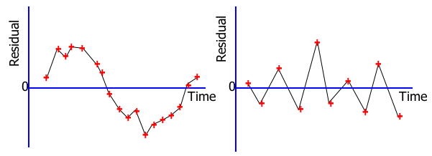
5 Non-independence of the Error Variable
Patterns in the appearance of the residuals over time indicates that autocorrelation exists:
Note the runs of positive residuals,
replaced by runs of negative residuals
Note the oscillating behavior of the
residuals around zero.

Slide 33
Procedure for Regression Diagnostics…
Develop a model that has a theoretical basis.
Gather data for the two variables in the model.
Draw the scatter diagram to determine whether a linear model appears to be appropriate. Identify possible outliers.
Determine the regression equation.
Calculate the residuals and check the required conditions
Assess the model’s fit.
If the model fits the data, use the regression equation to predict a particular value of the dependent variable and/or estimate its mean.

Slide 34
Multi-collinearity
Multiple regression models have a problem that simple regressions do not have, namely multi-collinearity.
It happens when the independent variables are highly correlated.
We’ll explore this concept through the following example…

Slide 35
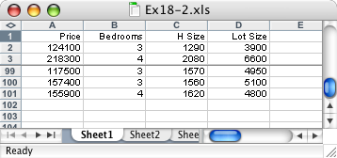

Example
A real estate agent wanted to develop a model to predict the selling price of a home. The agent believed that the most important variables in determining the price of a house are its:
u size,
v number of bedrooms,
w and lot size.
The proposed model is:
Housing market data have been gathered and Excel is the analysis tool of choice…

Slide 36
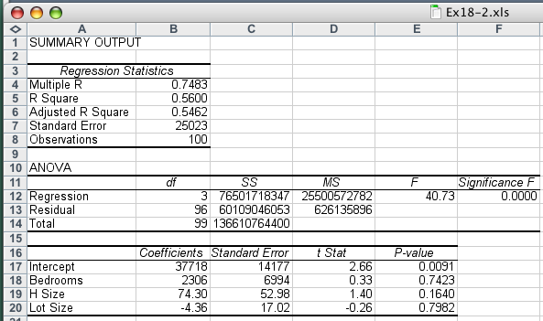
Example
Tools > Data Analysis > Regression…
The R square indicates the model is valid…
…but these t-stats suggest none of the variables are related to the selling price.

Slide 37
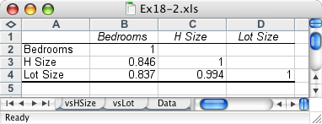
Example
How can the model be valid and fit well, when none of the independent variables that make up the model are linearly related to price?
The answer is that the three independent variables are highly correlated with each other !
Whenever, | r|>0.8, multicollinearity. The t-tests are no longer accurate.
Don’t drop any of those independent variables by the P-value reported, when we have multicollinearity.

